Slide 1
Introduction To Computer Security
Prateek Saxena

Slide 2
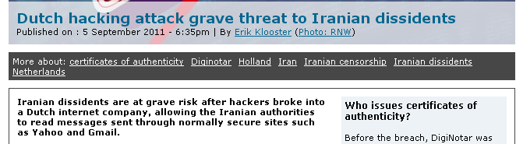

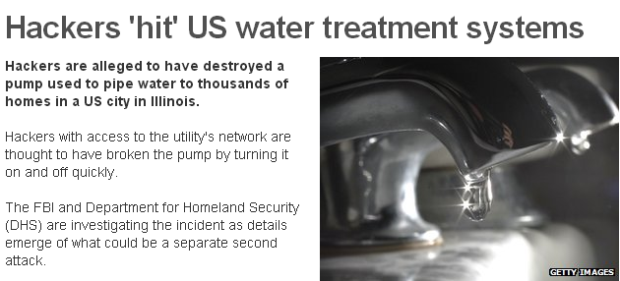
Threats to Lives?
Source: Rnw, BBC

Slide 3


Underground Economy
Bank account with $200K sold
Own a Machine for $0.40
$$$ for Installing Malware
E-passports for $12
Hack
Configure your malware!
Click Fraud, Spam services
Sell Services
Underground Market

Slide 4
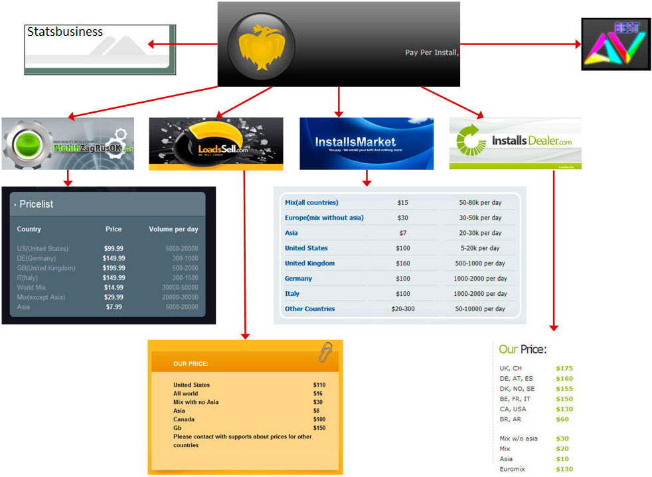
Underground Economy: Example of Pay-per Install Services

Slide 5
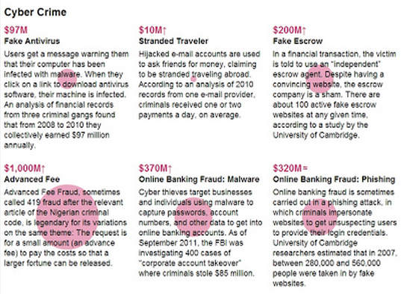
Underground Economy: Size of the Economy?
Source: Measuring cost of cybercrime
WEIS 2012

Slide 6
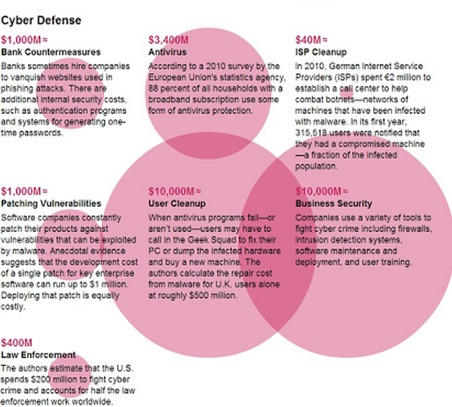
Underground Economy: Size of the Economy?
Source: Measuring cost of cybercrime
WEIS 2012

Slide 7
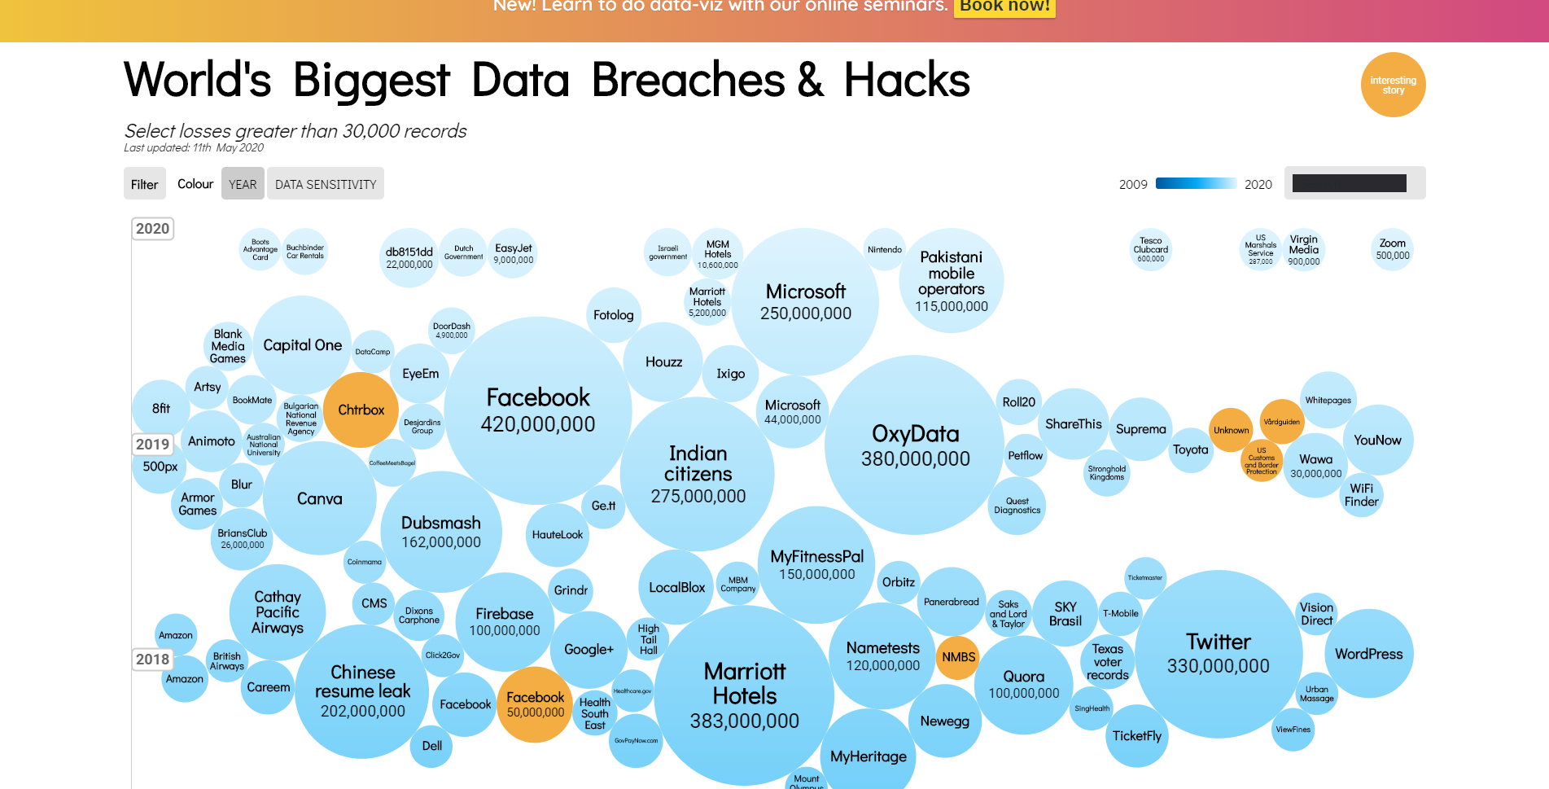
Data Theft of Personal Records
Source: https://www.informationisbeautiful.net/visualizations/worlds-biggest-data-breaches-hacks/

Slide 8
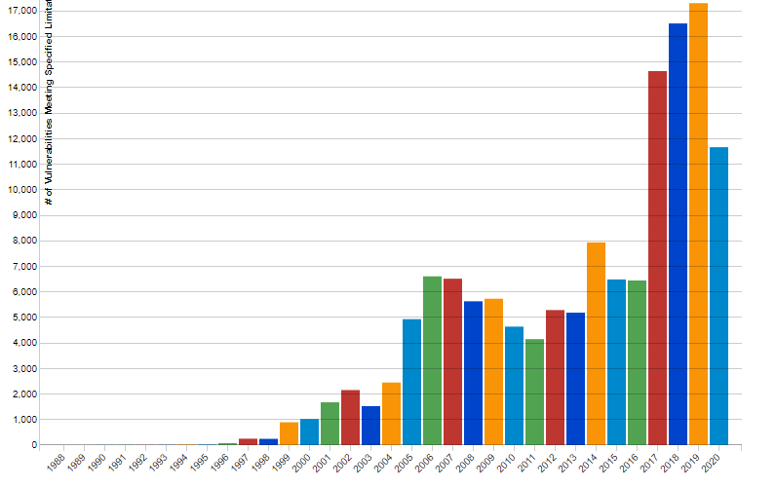
Software Vulnerabilities Over Time
# of vulnerabilities per year
Source: https://nvd.nist.gov/vuln/search/statistics?form_type=Basic&results_type=statistics&search_type=all

Slide 9
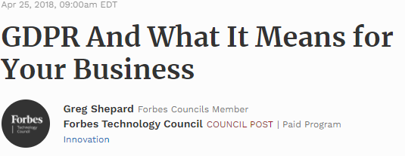
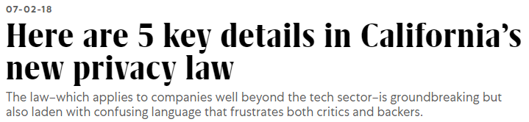
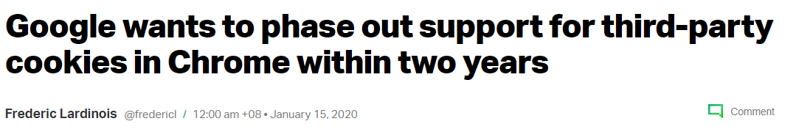
Privacy Regulations are changing
Additional Ref (GDPR fines): https://www.enforcementtracker.com/

Slide 10
Ask questions at will. Speak out your opinions freely. (Naïve questions are often great!)

Slide 11
What people say about security…

Slide 12
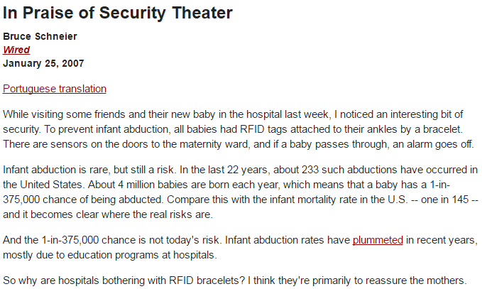
People’s sense of security vs. real security

Slide 13
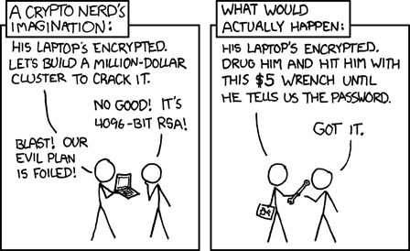
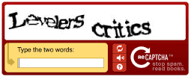
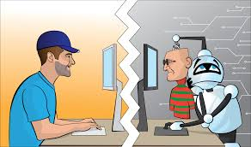
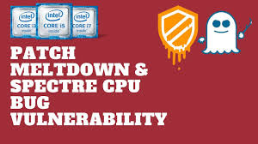
“Nothing Is Ever Secure…”
And, there is no point trying…..?

Slide 14
Objective of this module: How to Analyze and Argue Security?
Imagine you are asked to protect an email application (e.g. GMail)
What are possible attacks?
Database / server / cloud compromised
Insider gains unauthorized access
Network sniffing
Bugs in the web app
User impersonated
Password Breach
…

Slide 15
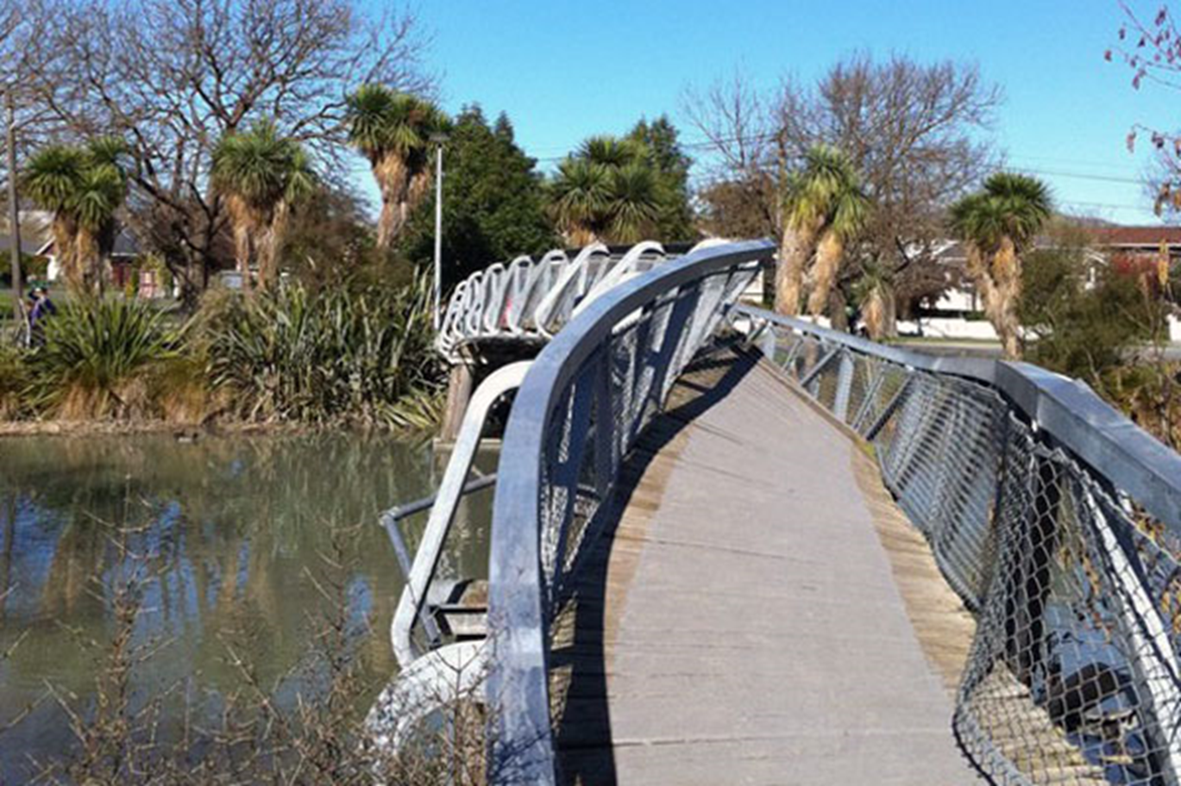
Clean-slate Rethinking Security: If we had to redesign computer systems…

Slide 16
Principles of Secure Design

Slide 17
A Key Concept: Threat Model
A Threat Model defines:
Desired Security Property / Goal
Attacker Capabilities
Assumptions about the setup
This Module:
Stack of Threat Models
Real attacks
Defenses for each threat
How to argue security!
User
Web Protocols
Browser & Server
Server / Client OS
Network

Slide 18

The Weakest Link Principle
Security can be no stronger than its weakest link.

Slide 19
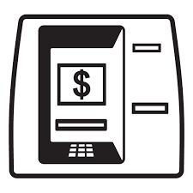
The Weakest Link Principle: Example
ATM Hacks , Fraud

Slide 20
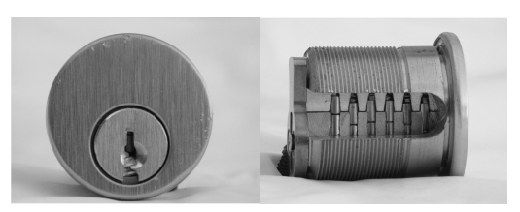
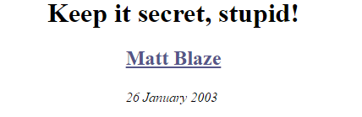
Kerckhoffs's Principle: Security-By-Obscurity is Bad
Original Attack, Public Response

Slide 21
Logistics

Slide 22
Logistics
Midterm Exam: 34%
Open-book, individually taken
In-class: Please see date on the webpage.
3 Homework Segments (66%)
Crypto (S1), Web Security (S2), Mem. Safety (S3)
Individually done
Score: Best-2-out-of-3, i.e., Max2(S1, S2, S3)
Main Content: Lectures
Tutorials: By TA tutors
Optional but strongly recommended
Tutorials will cover topics in greater depth
There is 1 tutorial online + 1 over Zoom per week

Slide 23
Logistics
TA and instructor will not “debug” code
Watch the module on LumiNUS and webpage: https://luminus.nus.edu.sg/modules/9cae4820-5786-4997-b367-e6d814cb179c
Default: All questions go to LumiNUS forum
Please do not email me / TAs with questions that are of general interest to all others (e.g. “When is this due?”). Use the LumiNUS forum instead so that the clarification is visible to everyone.
This is a large class and we can’t respond fast for repeated questions.
If you have something specific to your situation, please email us.
Academic Honesty
See course webpage for policy
Not OK to find answers via external means (alumni, friends, online blog, previous classes taken, etc.)
Severe Non-negotiable penalty of F grade, in line with NUS academic policies
Ethics: Responsible Disclosure about collaboration

Slide 24
Resources you’d need…
Webpage: CS3235
LumiNUS:
For tutorials and assignments, bring a laptop with:
Second tutorial onwards
VirtualBox installed
Linux virtual machine (e.g.):
http://mirror.nus.edu.sg/ubuntu-ISO/18.04/ubuntu-18.04.5-desktop-amd64.iso
(TA might send an announcement for updated link on LumiNUS)

Slide 25
Pre-Requisites & Workload
Basic Mathematics (Groups, Mod Arithmetic, Prob.)
Working knowledge of C, PHP and JS programming
Concepts of Operating Systems
Complete the Pre-requisite quiz on LumiNUS [Week 1]
If you score below 50%, you’re strongly advised to drop this module
Self-paced and encourages self-learning
Warning: Module is a bit “heavy”
Trains you in elementary mathematics / crypto
Trains you to write secure code
Flavor of advanced computer security topics
Formally argue security or lack of it

Slide 26
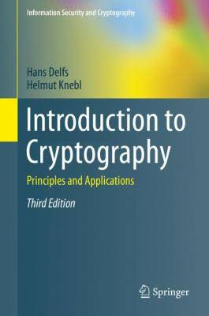
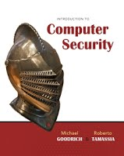
Textbooks
There is no recommended textbook
Lecture notes (slides), tutorials, homeworks are it!
Listen, take notes, question and do research
Exams & Homeworks will extrapolate…
[Optional] Supplemental Reading:

Slide 27
Caution: Prior Student Feedback (Anonymized)
“Lectures are conceptual, assignments and quizzes expect to understand things in depth”
There is a gap between theory and systems in security. Live with it!
Lectures provide theoretical understanding. Please tune in to the class.
The assignments / handouts expose the details. These are important!
The quizzes will test your understanding of both.
“I spent 4 hours installing VMs, debugging the differences between addresses inside/outside GDB … fixing typos in handouts and external references… with little help”
I have planted at least 10 typos for you to catch! ☺
In coding assignments, nothing works out-of-the-box. Learn to tinker!
I know that you come from very diverse backgrounds, some non-CS too. But, be resourceful and sharp. Figure out the typos, unknown terms, etc. There is just no textbook for this kind of module.

Slide 28
Uniqueness of This Module
The Attacker Perspective: A New Viewpoint
We aren’t teaching you an artefact (e.g. OS, DB)
We’re teaching you how not to build it!
As much about “new knowledge”, as about
Making sound security arguments (with threat models)
Principles and abstractions of “secure” construction
The Spirit: DIY and open-ended thinking
Thought Experiment: Choose between
A grade
Learn a lot
Which one will you choose
Notes:
Pen Test legal

Slide 29
Break!

